Slide 1
Deep Learning Approaches for H&E to Multiplexed Immunohistochemistry Image Stain Translation
Chang Bian | 12/12/2024
Institution: Division of Informatics, Imaging & Data Sciences
Faculty of Biology, Medicine and Health University of Manchester
Supervisors: Martin Fergie; Tim Cootes; Beth Phillips

Slide 2
Contents
Notes:
Name,

Slide 3
Introduction
Notes:
Name,

Slide 4
Thesis structure
Notes:
Name,

Slide 5
Chapter:
Notes:
Name,

Slide 6
Chapter:
Notes:
Name,

Slide 7
Chapter:
Notes:
Name,

Slide 8
Chapter:
Notes:
Name,

Slide 9
Chapter:
Notes:
Name,

Slide 10
Conclusion
Notes:
Name,

Slide 11

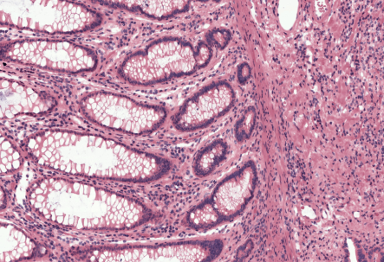
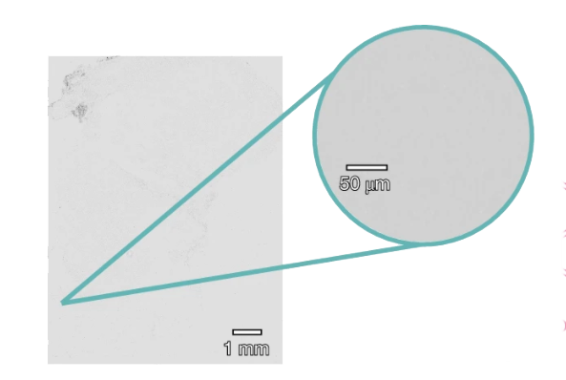
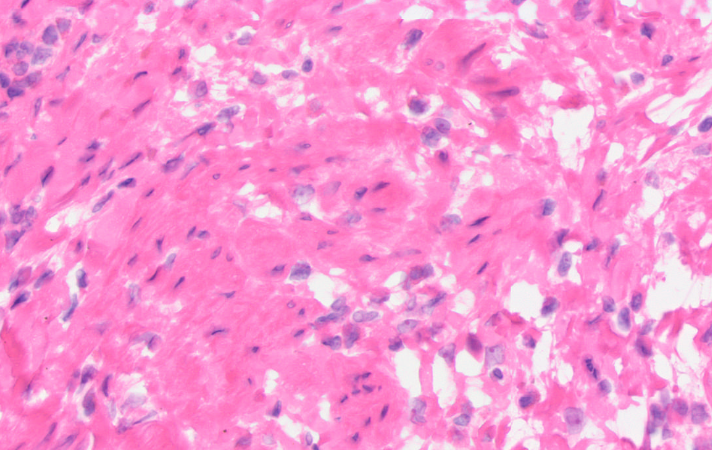
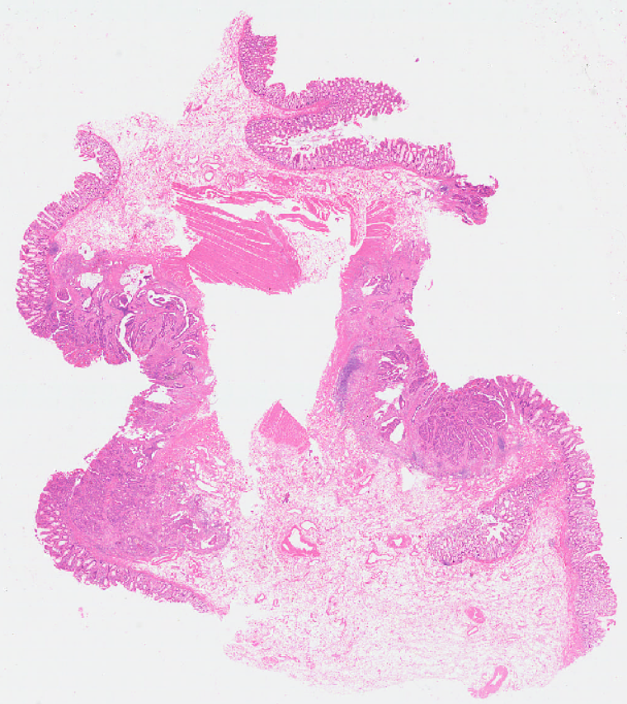
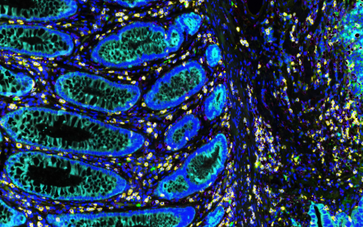
Research 1
HEMIT: H&E to Multiplex-immunohistochemistry Image Translation with Dual-Branch Pix2pix Generator
Background
Pathological diagnosis
Staining methods
histological staining
H&E
unstained tissue section
stained tissue section
low cost
Simple preparation process
Can not identify specific protein markers
mIHC
high cost
complex preparation process
Can provide information on protein expression
microscope imaging
Question: How to acquire mIHC image data more efficiently?

Slide 12
Research 1
HEMIT: H&E to Multiplex-immunohistochemistry Image Translation with Dual-Branch Pix2pix Generator
Aim
CNN
Input: H&E
Output: mIHC
Develop a computational method that takes the H&E image as input, then translates it
into mIHC image of the same section.

Slide 13
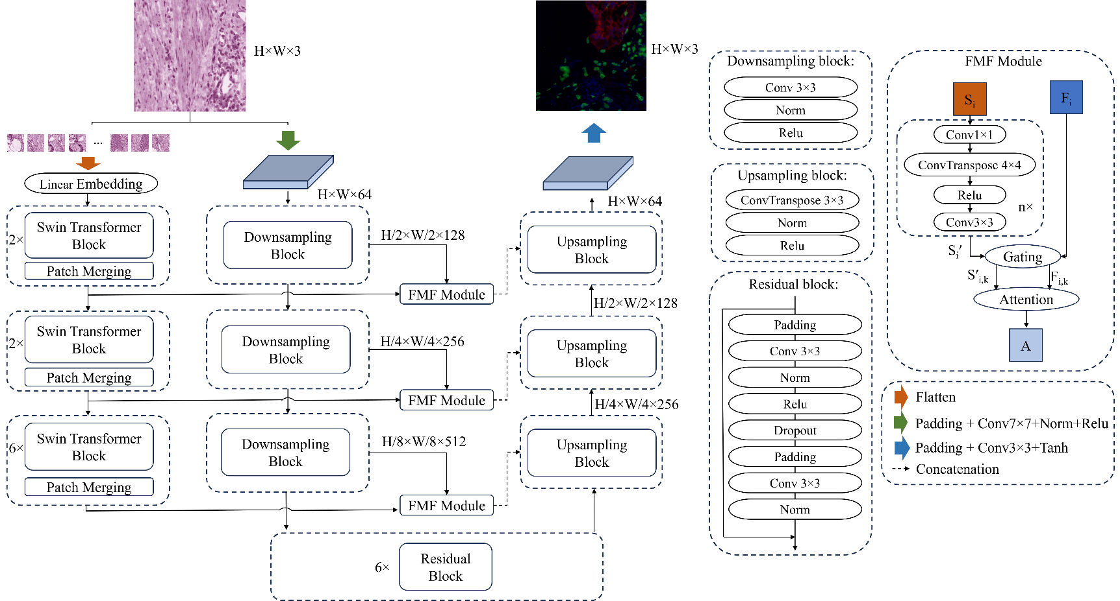
Research 1
HEMIT: H&E to Multiplex-immunohistochemistry Image Translation with Dual-Branch Pix2pix Generator
Methods
Established a cellular-level aligned dataset for supervised H&E to mIHC stain translation
Proposed a SwinTransformers-ResidualCNN dual branch network architecture for multiscale information integration
Proposed a downstream analysis pipeline to supplement the evaluation metrics in the computer vision world
Notes:
1.Data-driven method: dataset establishment
2.Based on the characteristics of pathological image data, we proposed a ….. Leverage information from different scales, with small regions containing details of cell texture, color, shape etc, and large regions with the distribution patterns of cell clusters and stroma area and their interaction status.
3. In addition to the evaluation metrics that are commonly used in the CV world, we also proposed a downstream analysis pipeline to validate the utility and quality of the generated images from a clinical perspective

Slide 14
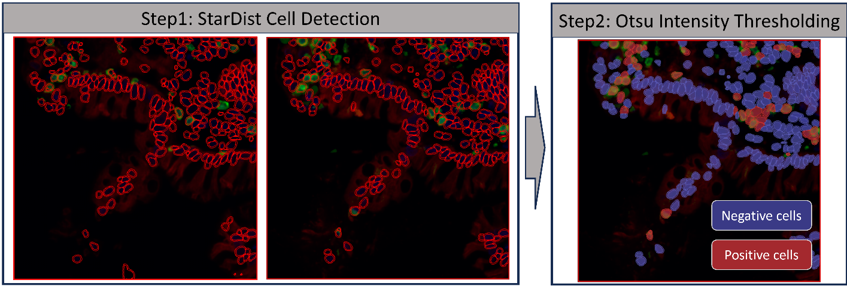
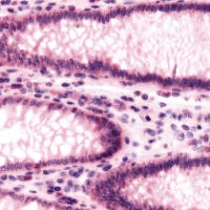
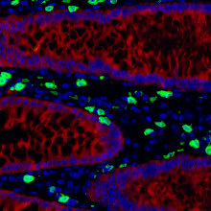
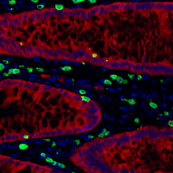
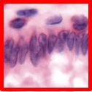
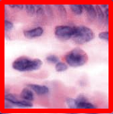
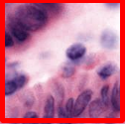
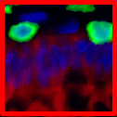
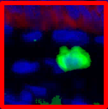
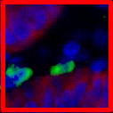
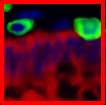
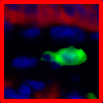
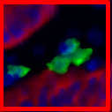
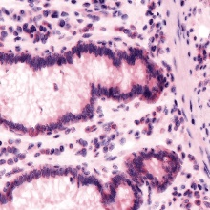
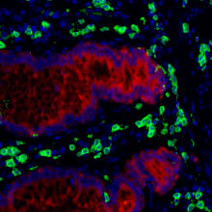
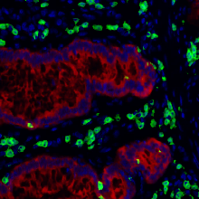
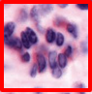
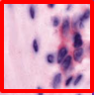
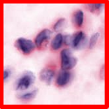
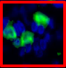
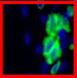
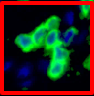
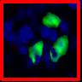
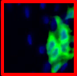
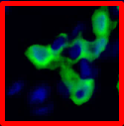
Research 1
HEMIT: H&E to Multiplex-immunohistochemistry Image Translation with Dual-Branch Pix2pix Generator
Results
Real mIHC
Virtual mIHC
Best performance among 3 key evaluation metrics (SSIM, Pearson, PSNR)
Best performance in downstream evaluation tasks (total cell counts, positive CD3 cell proportion, etc.)
H&E
Real mIHC
Virtual mIHC
Notes:
Figure explain, color explain
In addition to using traditional machine learning evaluation metrics such as Similarity, Structural Similarity Index Measurement (SSIM), Pearson Correlation, and PSNR to evaluate our method, we also performed some downstream analysis tasks for further validation. Specifically, we utilized existing cell analysis software, such as QPath, to process both the generated virtual MIHC images and the real MIHC images. This downstream analysis involved comparing the virtual and real MIHC images in terms of various metrics, such as the number of cells and the number of positive cells, the proportion of positive cells etc.
By conducting these downstream analysis tasks, we aimed to assess the model's performance in practical application scenarios beyond traditional machine learning metrics.

Slide 15
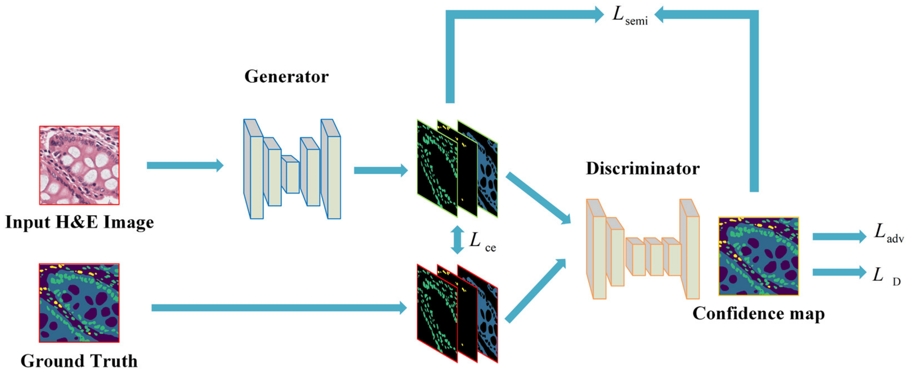
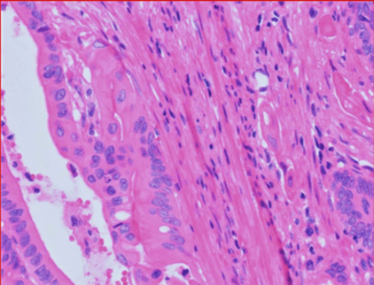
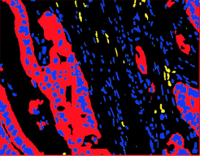
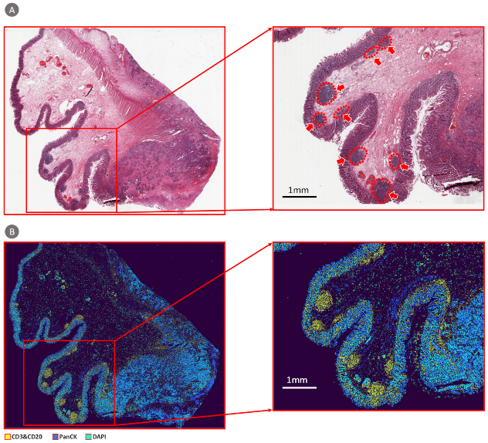
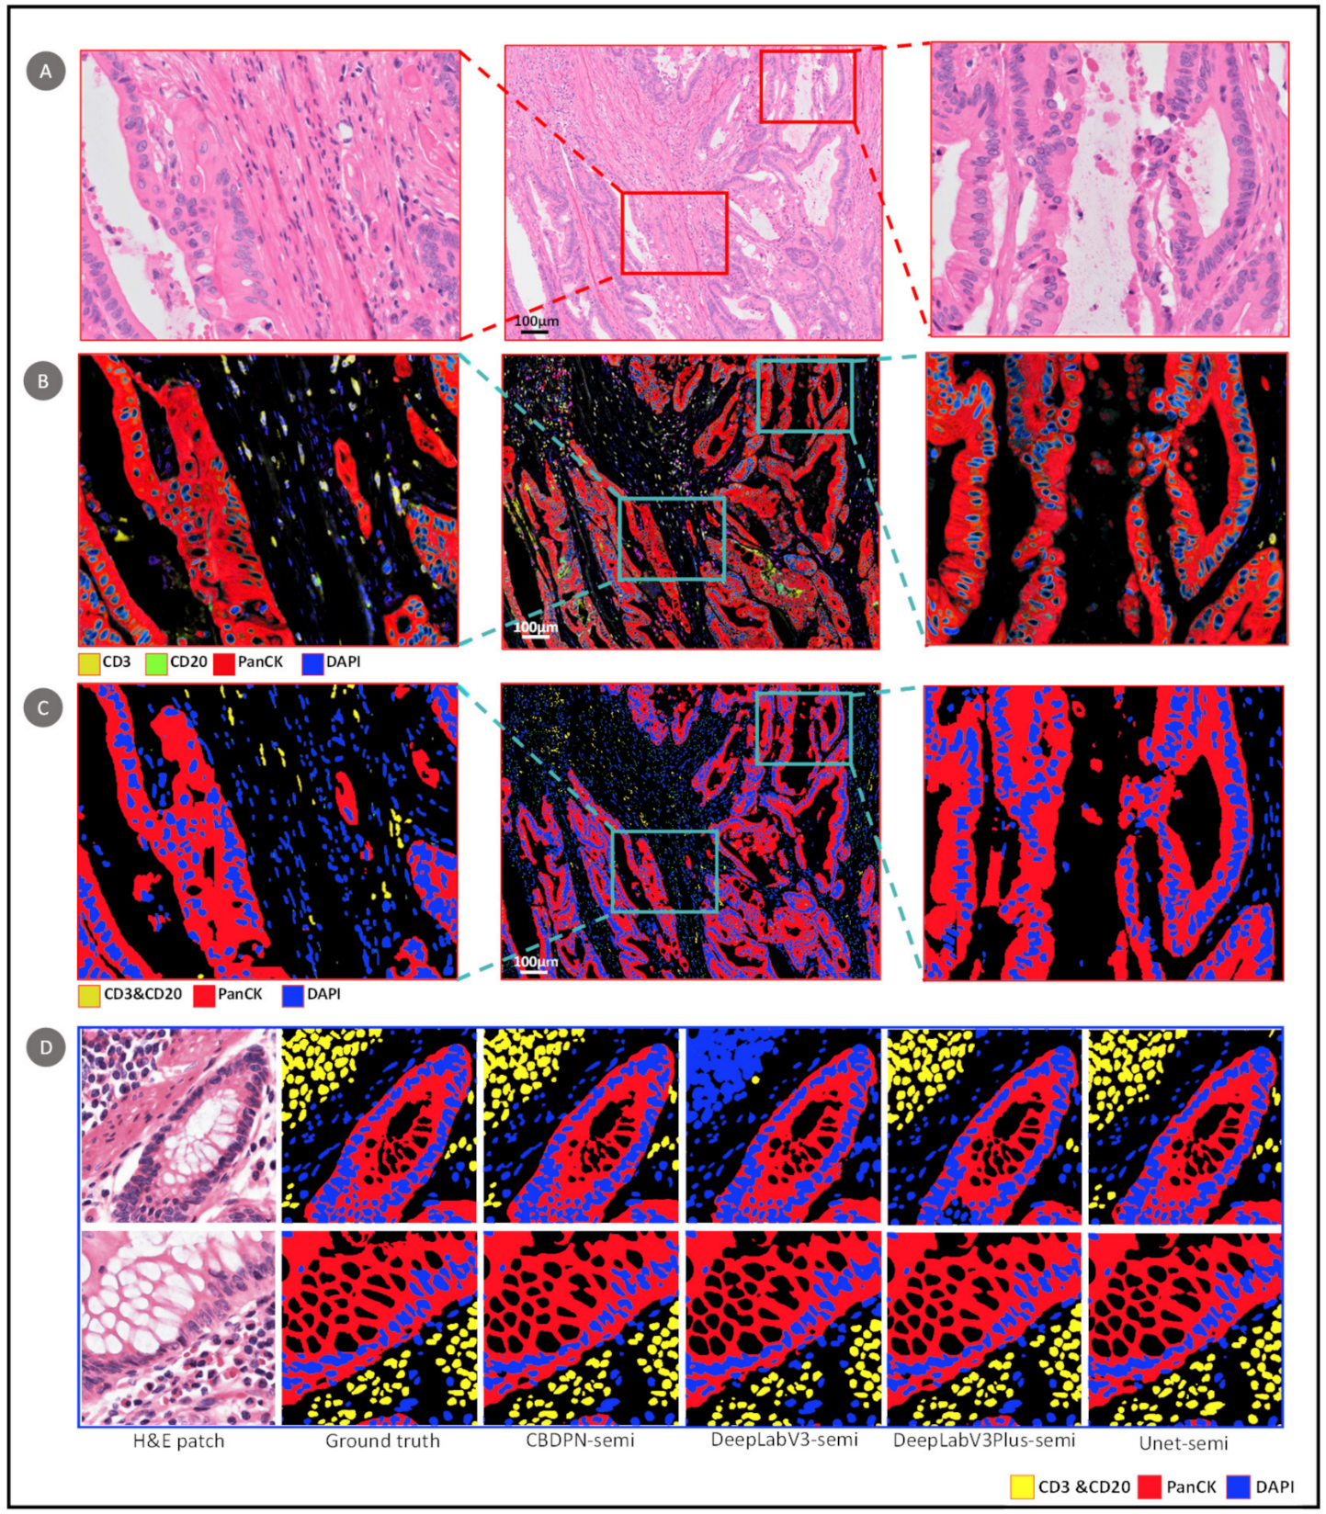
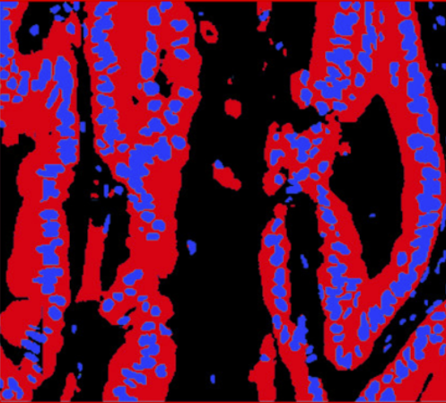

Research 2
Methods
Semi-supervised methods for TILs segmentation
Background
TILs play a key role in predicting the immune response against tumors.
Accurate segmentation methods require a huge amount of annotated data.
Manual labelling/annotation is time-consuming and labor-intensive.
H&E Image
Results
Segmentation map
Aim
Annotated data
Semi-supervised framework
Unlabeled data
Accurate segmentation
Test set validation
TCGA validation
Notes:
Title, motivation lies in that BG, aim,
our semi-supervised biomarker distribution prediction network utilizes an adversarial learning paradigm
It can leverage part of labeled data and large amount of unlabeled data, the network is trained in a progressive manner and the unlabeled data will be trained using a confidence map which pinpointing the confident regions.
Both test set and TCGA validation shows that the proposed method can improve the segmentation performance by incorporating additional data source.

Slide 16
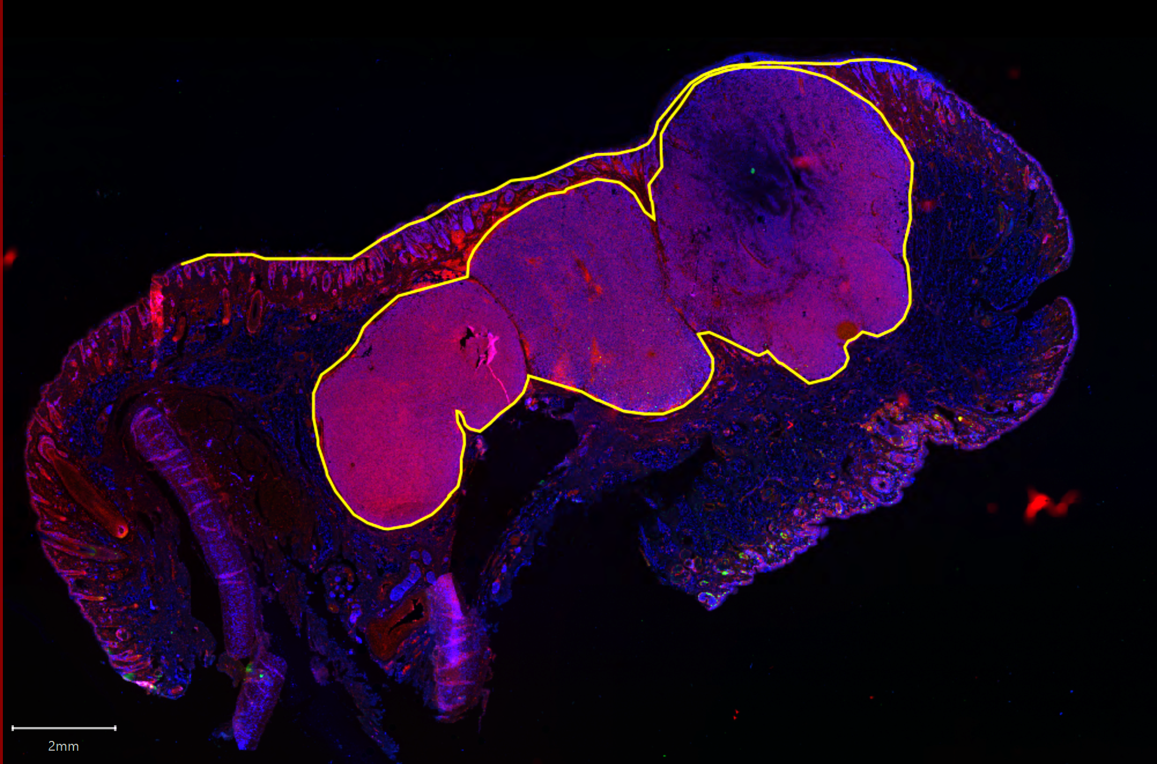
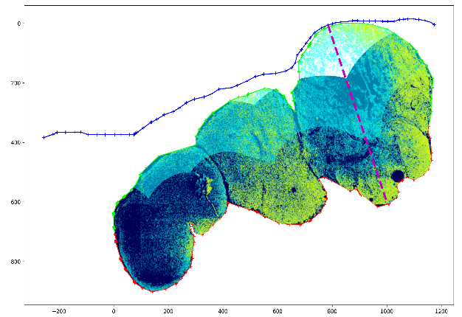
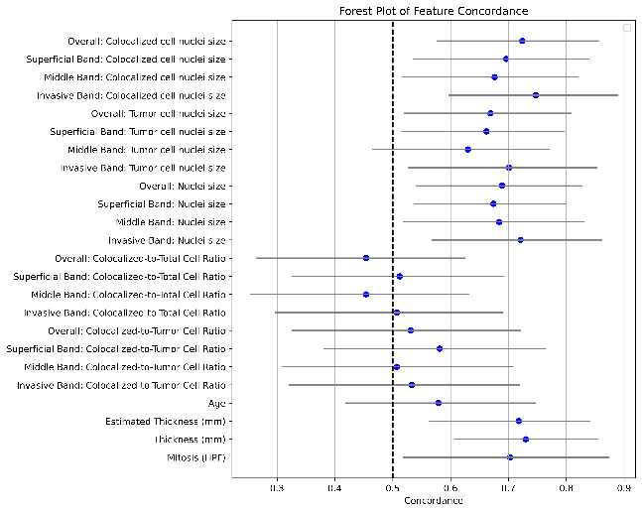
Research 3
Methods
mIHC slide
Spatial analysis
Spatial analysis of melanoma to predict risk of relapse.
Superficial band
Middle band
Background
Cell morphology reflects certain molecular signatures
Naevoid melanomas subtype shows better prognosis with features simulating maturation, including changes in cell size and distribution.
Invasive band
Spatial information
Survival analysis
Clinical records
Aim
Results
Develop a computational pipeline to analyse melanoma across the depth of the tumour.
Establish whether there are potential prognostic biomarkers:
Proliferation
Nuclear Morphology
Targeted hypotheses to enable a small cohort study
CoxPH model evaluating the potential of spatial-related biomarkers
Notes:
Title,
This is a preliminary work with a prespecified hypothesis based on previous works: naevoid, investigate in detail.
This is a collaborative project with pathologists from st George’s hospital of UK, my job is focused on the computational part.
Aim: 1, 2,
The way I approach this problem is to split the whole melanoma region into 3 consecutive spatial bands according to the distance to the invasive margin. (explain 3 bands)
Quantify cell size, cell nuclear size , proliferation density within these bands and use a COX model to examine the prognostic value.
COX PH Results have demonstrated the potential of nuclear size in the invasive band, limitation, future work

Slide 17
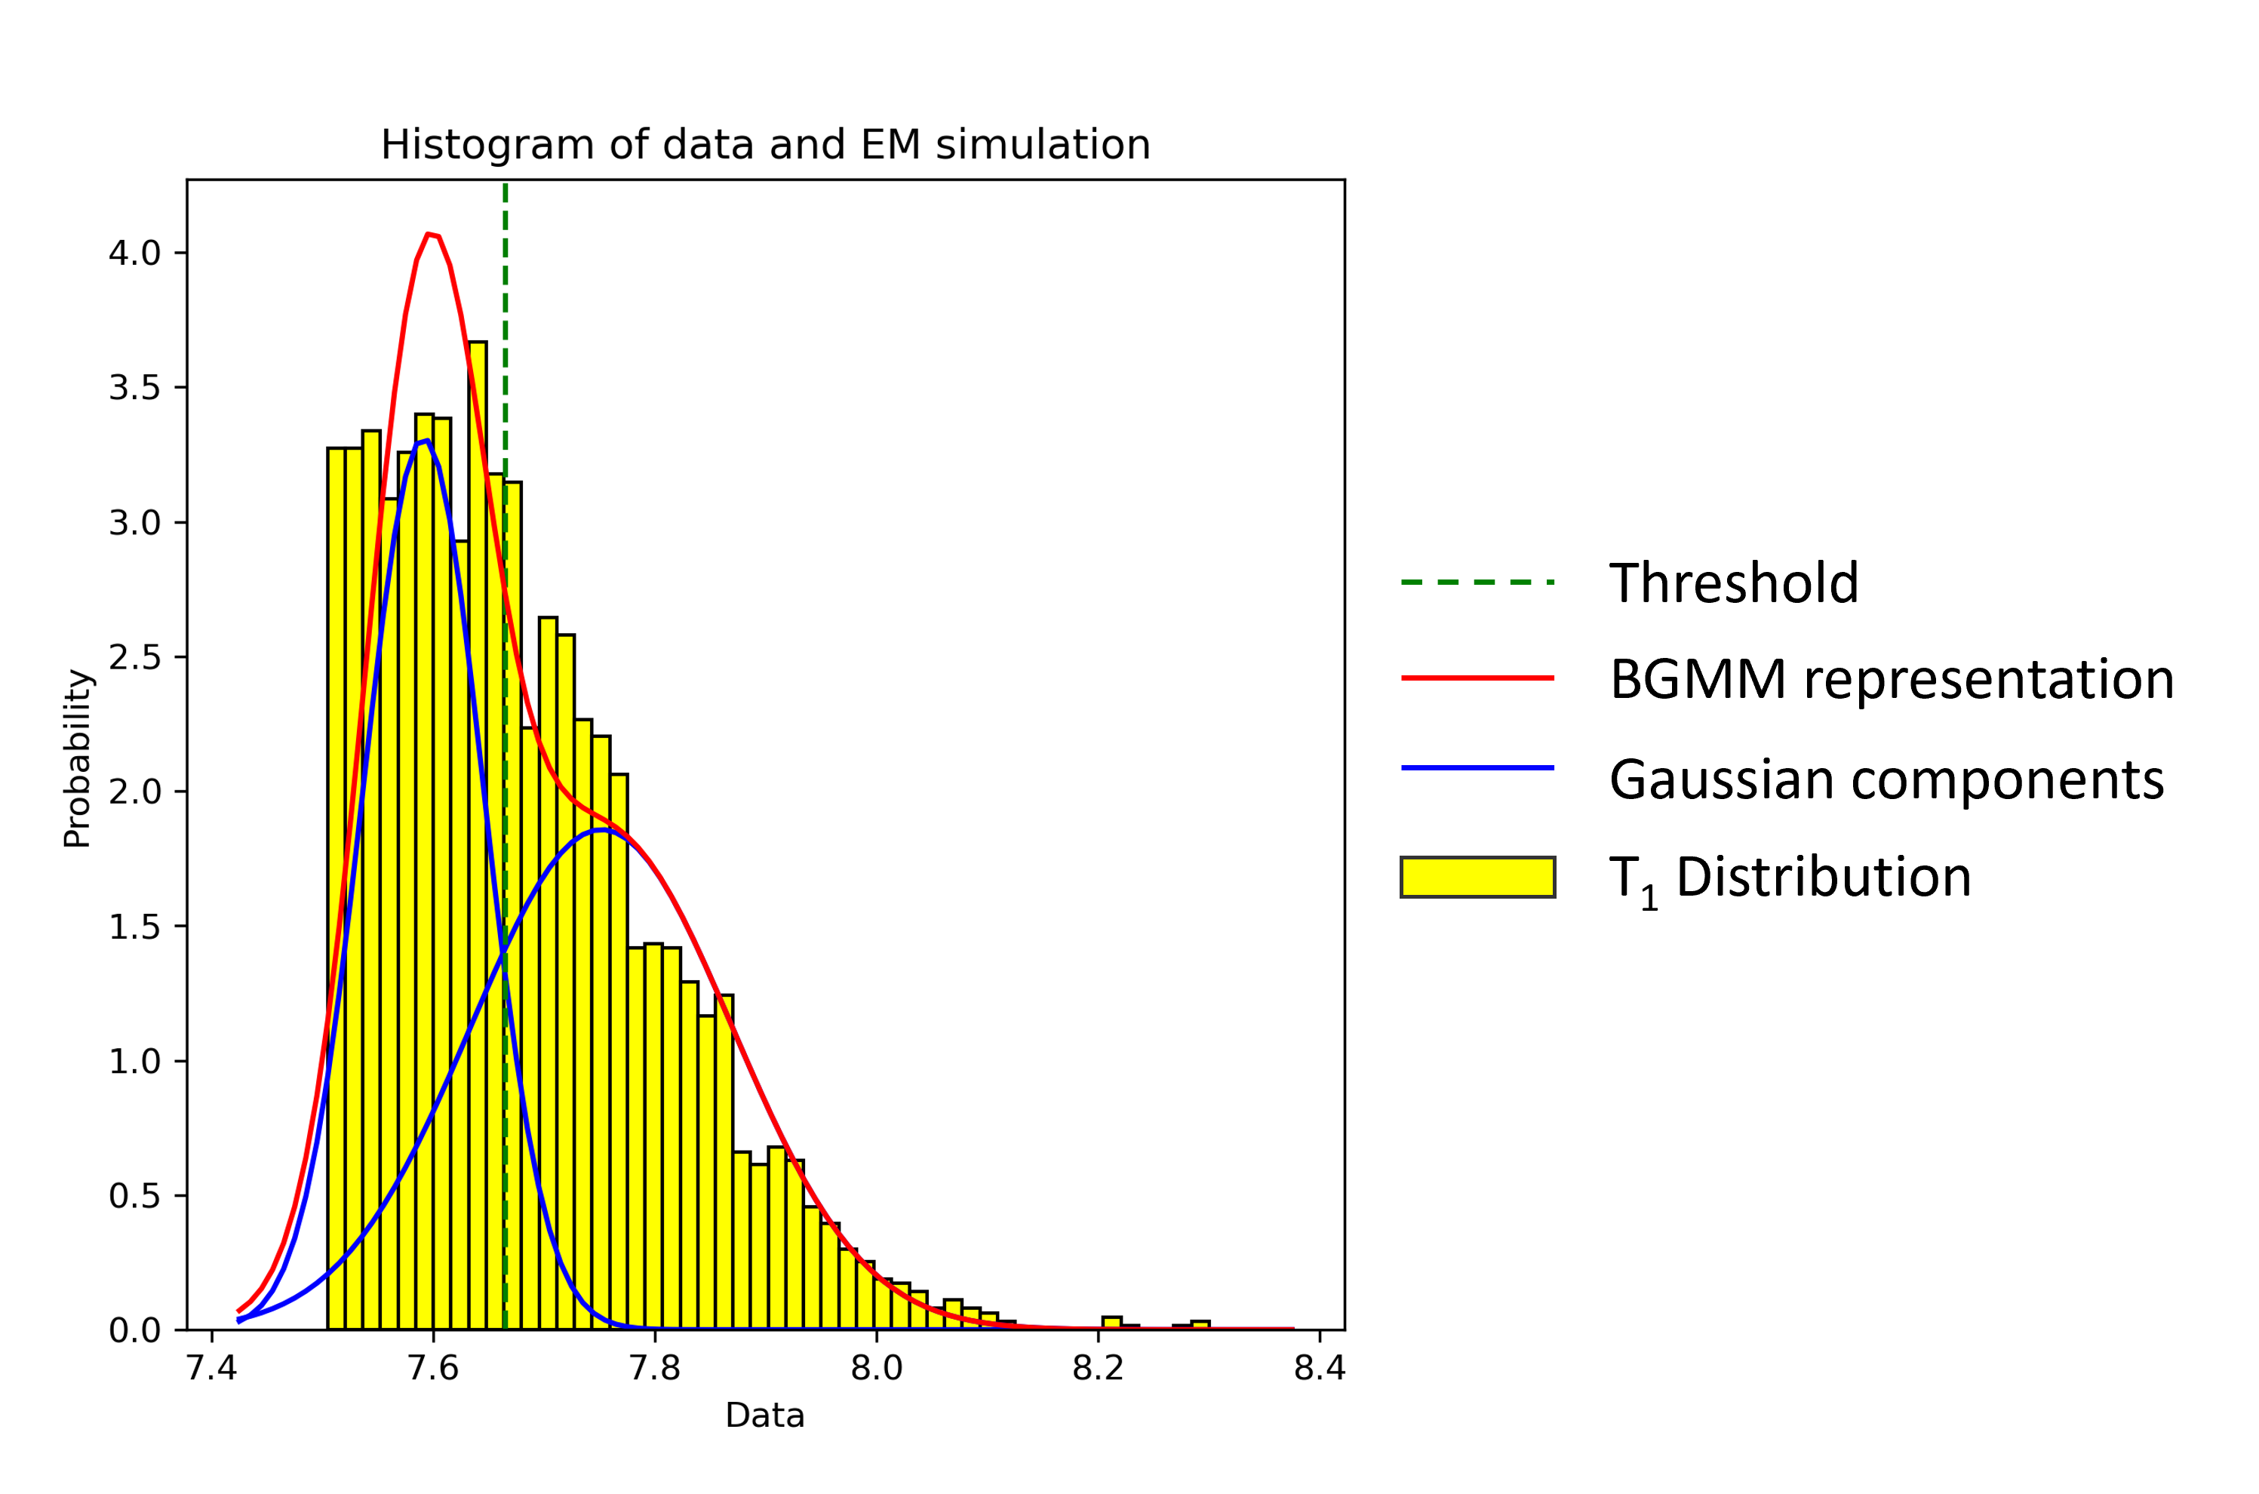
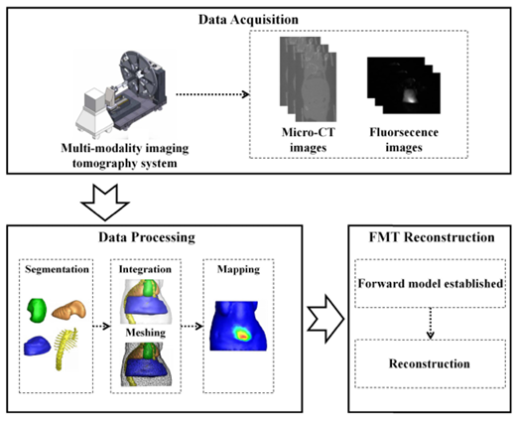
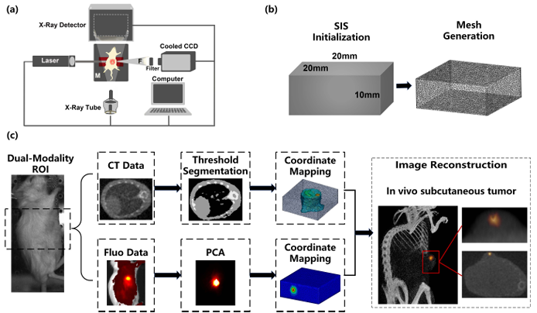
Other research experiences
mIHC slide
Adaptive thresholding method for mIHC image analysis
Adaptive parameter search method for fluorescent molecular tomography
A fast and automated FMT/XCT reconstruction strategy based on standardized imaging space
Developed statistical model-based method to adaptively threshold each marker into +ve/-ve.
Benefits:
Improved repeatability.
Less subjectivity in assessment.
Robust towards staining variability.
Proposed a standardized imaging space reconstruction (SISR) method for FMT/XCT reconstruction, achieving the automation and standardization of FMT prior information acquisition.
Achieving better location accuracy, and spatial resolution compared with SOTA methods.

Slide 18
Research Experiences
Publications & Licenses
Peer reviewed Journals:
IEEE Transactions on Medical Imaging
Cancers
Medical Imaging: Digital Pathology
Conferences:
SPIE Medical Imaging
MICCAI Conference (In preparation)
Patents:
Method, system, and device for predicting cellular protein marker expression based on digital pathology images, Patent number: ZL 2020 1 1606836.8 (Chinese Patent)
Paper Review
Serving as a reviewer for the British Machine Vision Conference (BMVC)
Serving as a reviewer for the Journal of Medical Imaging
Serving as a reviewer for the International Conference on Electronics, Communications and Networks (CECNet)

Slide 19
Awards & Achievements
Best First-Year PhD Student Showcase Presentation, University of Manchester (UK)
University of Manchester and China Scholarship Council Joint Scholarship Program, University of Manchester (UK)
Graduate Scholarship for Academic Excellence, University of Chinese Academy of Sciences (China)
Best Innovation Award in the Full Quantitative Optical In Vivo Imaging Competition, Chinese Academy of Sciences Key laboratory of Molecular Imaging (China)
Outstanding Graduate, Xidian University (China)
First-Class Scholarship, Xidian University (China)
Special Prize in 2017 National English Competition for College Students, Advisory Board for College Foreign Language Teaching, College English Teaching & Research Association of China (China)

Slide 20
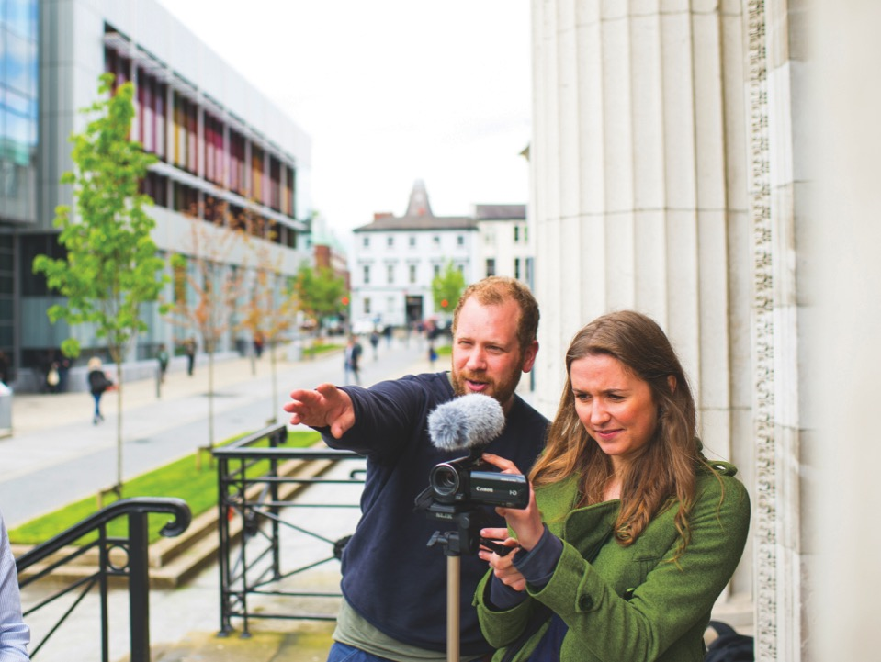


Thanks for listening
Chang Bian
Division of Informatics, Imaging & Data Sciences
School of Health Sciences
Faculty of Biology, Medicine and Health
University of Manchester
Email: chang.bian@postgrad.manchester.ac.uk

